Slide 1
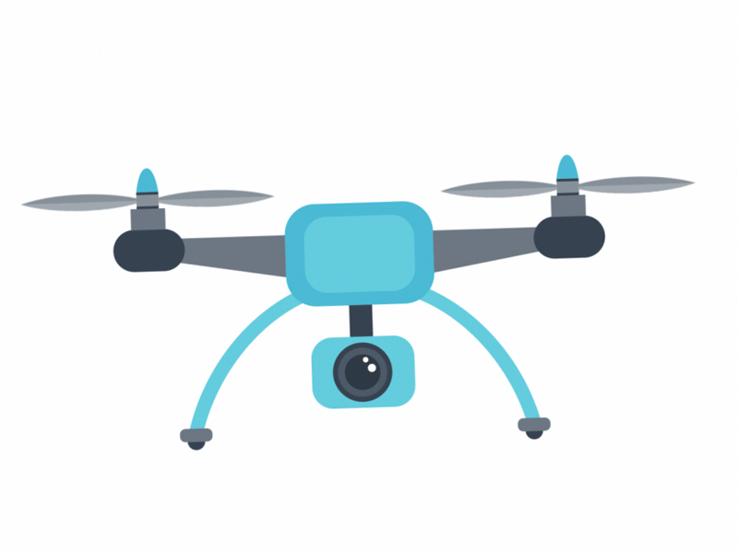
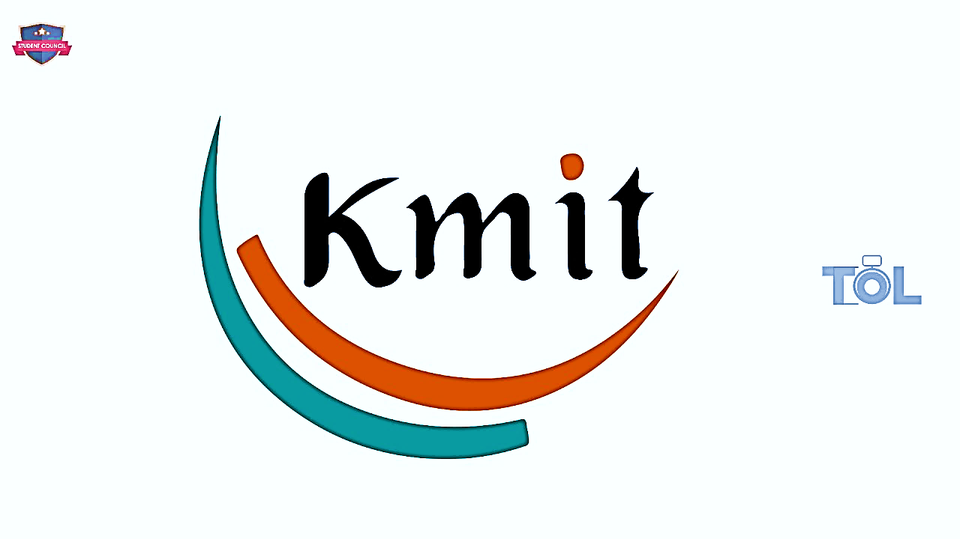
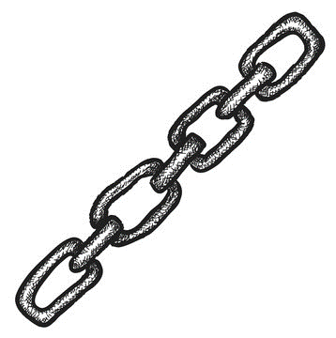

Problem Statement : Drone Setup to establish Long Range High Speed Line of Sight Wireless Communication System
Nagendra Kamesh M S

Slide 2


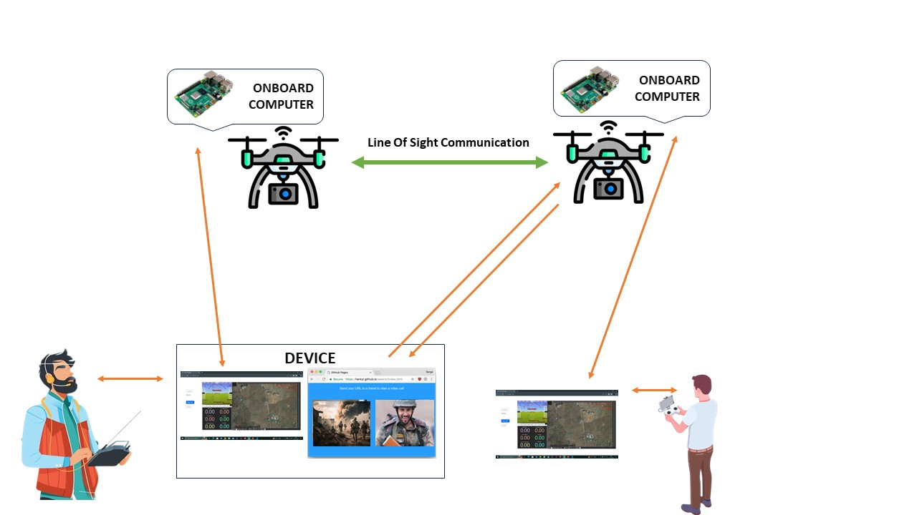








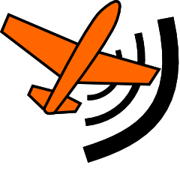
Overview
Workflow
An independent private point-to-point Line of Sight wireless network connection is established between two drones which are distantly located (Long Range). Through this connection, the signals or data can be sent/exchanged between two parties (which requires no internet or cellular connection) with high speed.
→ In our product, we focused on developing real-time video communication system utilizing that network connection. A web interface is developed for real-time Drone control and Analysis. Another web interface is developed to establish the video communication.
→ This system is helpful for two military or rescue groups especially in war torn or disaster prone areas to establish a video communication where there is no other scope of communication.
Line Of Sight
Long Range
Communication
Send commands to Onboard computer to Drone for real-time communication
Send commands to Onboard computer to Drone for real-time communication
Exchange Video streams
Interacts with
Device
Interacts with Application
Drone Alignment App
Video Communication App
Drone Alignment App
Device connected to Ground Control Station
Hardware Specifications
* Quantity in ()
Drone Frame : EFT E410P (2)
GPS : Neo-M8N (2)
Battery : 6S Li-Polymer (2)
Flight Controller : Pixhawk (2)
Motor : HobbyWing X8 (8)
Onboard Computer : Raspberry Pi (2)
Propellers : 30 inch (8)
Short Range Router : Tenda O3 CPE (4)
HD Camera (2)
Long Range Router : TP-Link CPE710 (2)
Languages
Web Technologies
Drone Tech
Python
WebRTC
ReactJs
MavLink
JavaScript
Flask
DroneKit

Slide 3
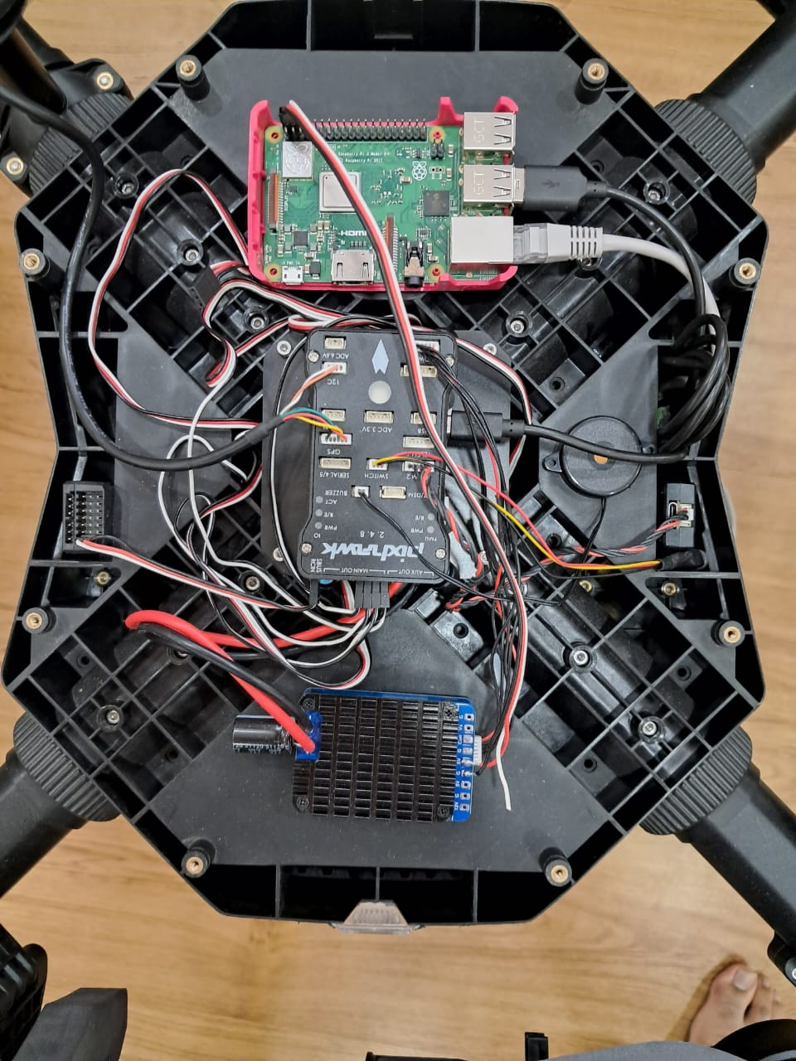

Slide 4
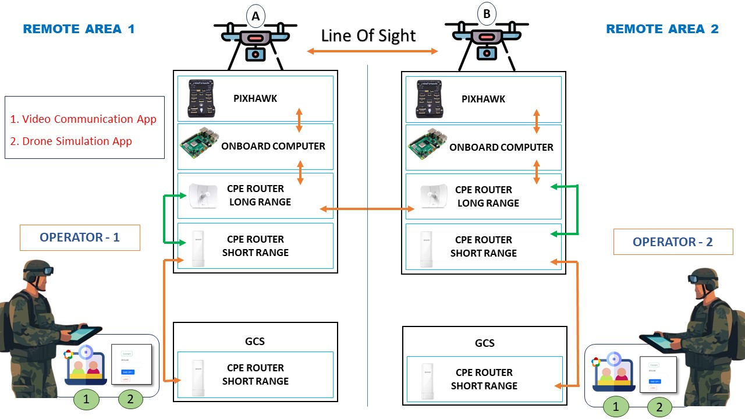
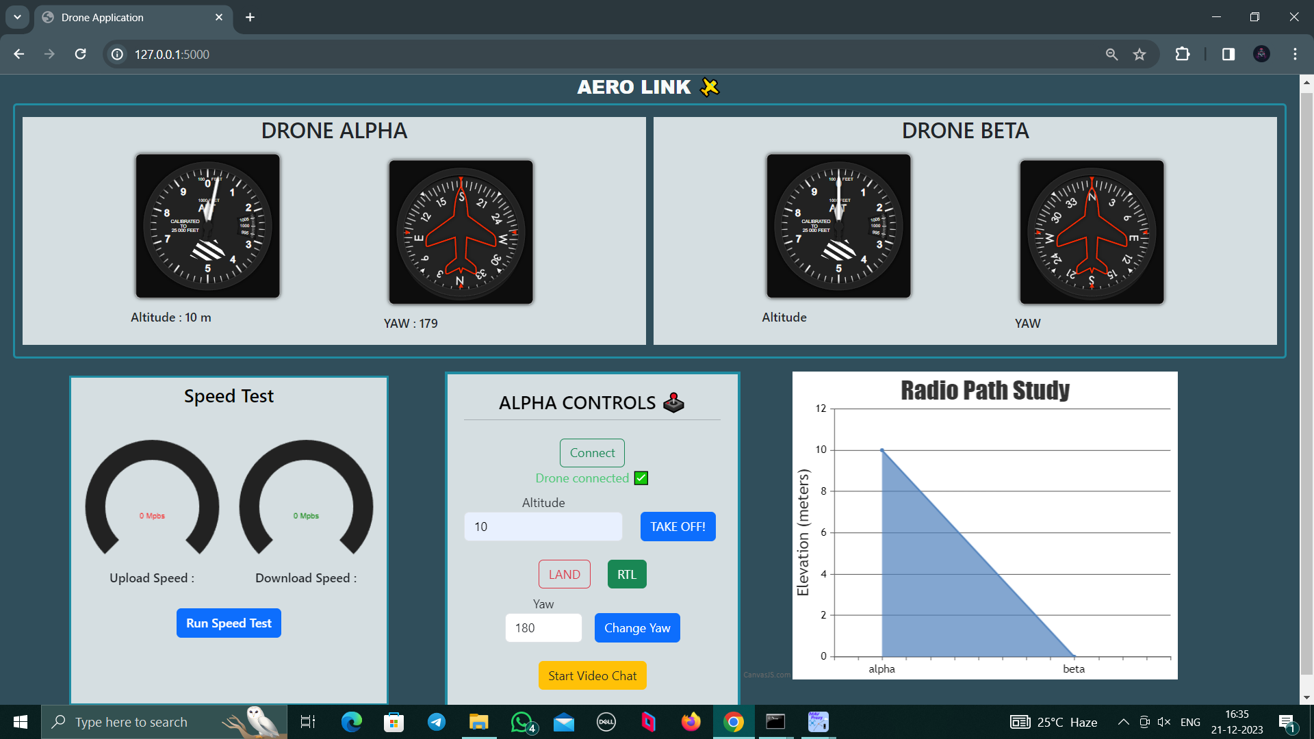
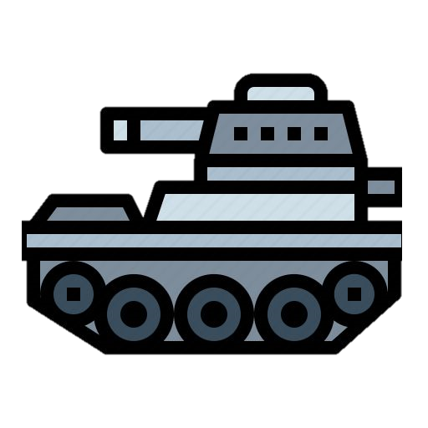



Use Case Diagram
AeroLink Application
Long Range connection
established
b/w Drone A and Drone B
1. Video Communication App
2. Drone Alignment App
Wireless
Show Stoppers
Use Cases of the Product
→ Line of Sight for drones is necessary to establish communication and establishing LOS is an unavoidable challenge
Drones can be used to gather intelligence, acquire and designate targets, and relay communications
Wars & Military
→ The maximum distance between the drones is 38 Km
Disaster Management
Drones can be used to communicate, assess, and search and rescue in disaster zones
→ Active jammers may cause obstacle in establishing communication
Remote Area Connectivity
Drones can establish reliable communication links in
remote areas, enabling essential operations
→ Legal Permissions are required to operate drones with private connection
Internet Tethering
Drones can be used to establish and provide backup connectivity, and deliver internet to disaster zones

Slide 5

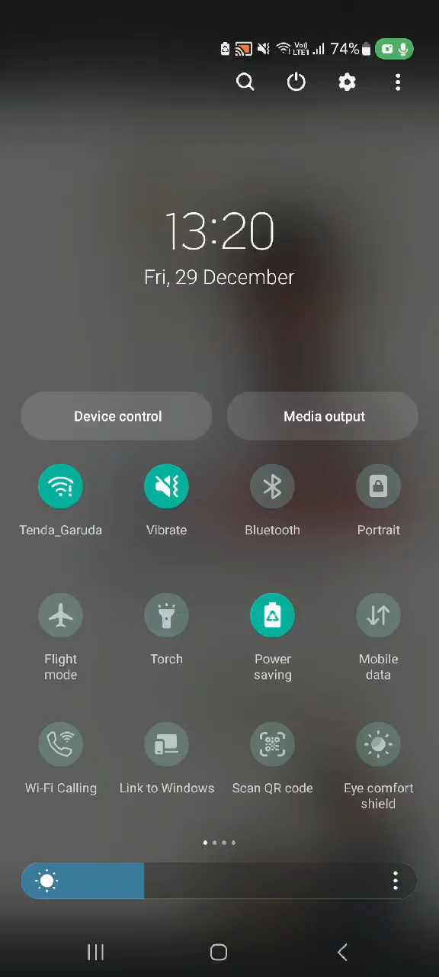


Slide 6
